Slide 1
INTRODUCTION TO PYTHON IDLE CONSOLE

Slide 2
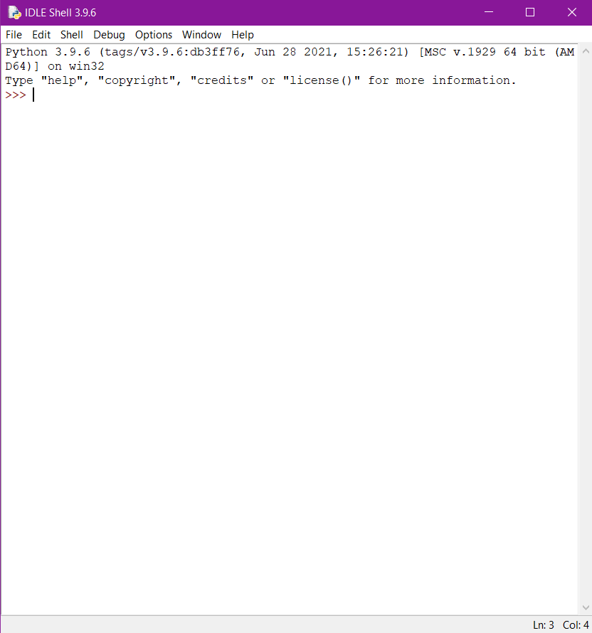
INTERACTIVE MODE
In interactive mode, one line of code can be written at a time in the command prompt.
The IDLE Shell checks for errors in the single line of code. If found, it throws an appropriate error message.
Otherwise, it asks for the next line of code.

Slide 3
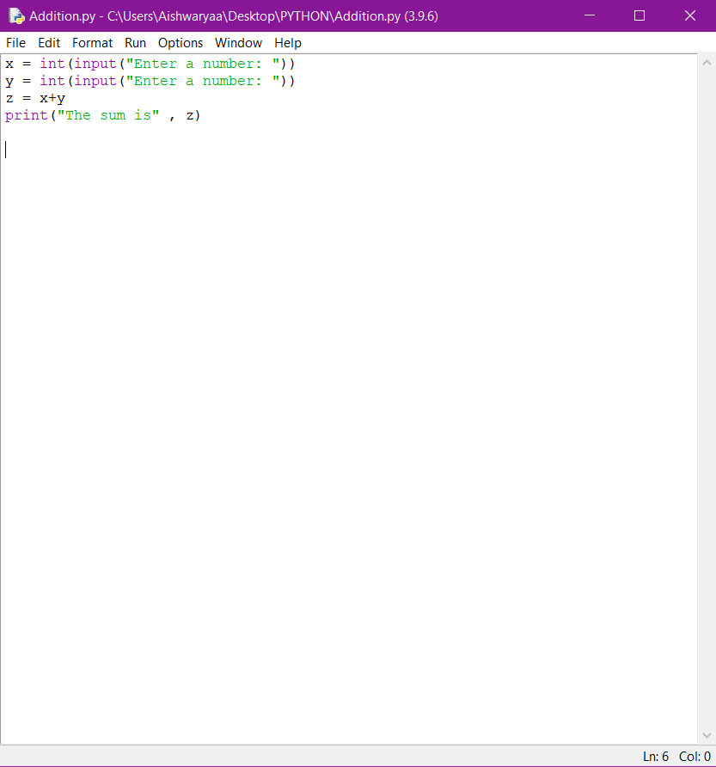
SCRIPTING MODE
In scripting mode, all lines of a code have to be written at a time.
The complete code is written before we execute the output of the code.
The IDLE Shell checks for errors in every single line of code during the Run. If found, it throws an appropriate error message.

Slide 4
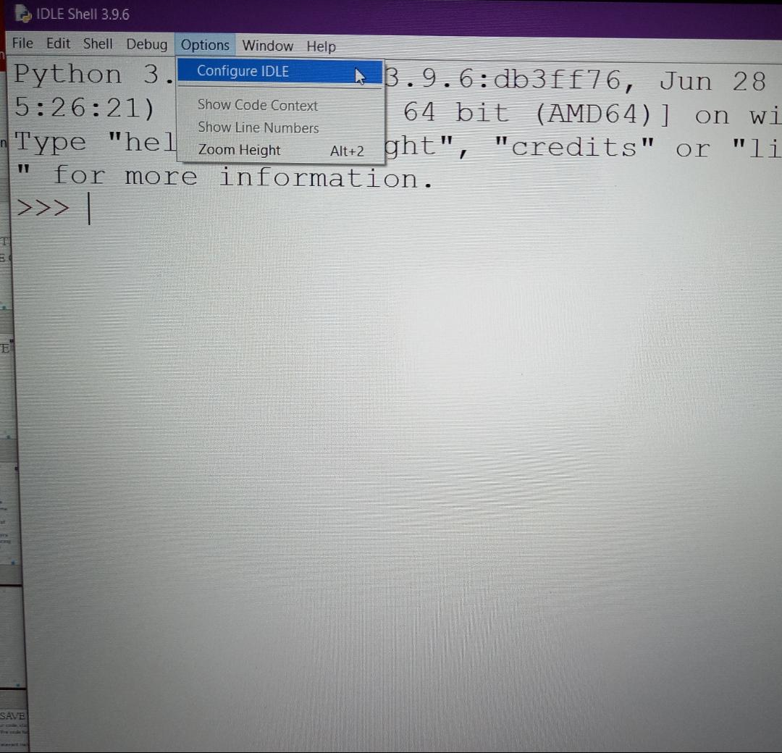
INCREASE FONT SIZE
To increase the font size of IDLE, click on Options and then Configure IDLE.
Change the Size and then click Apply.

Slide 5
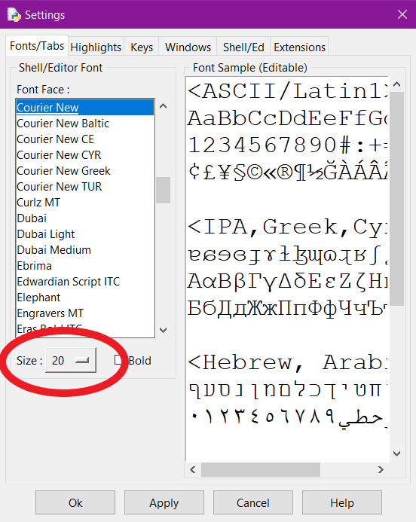
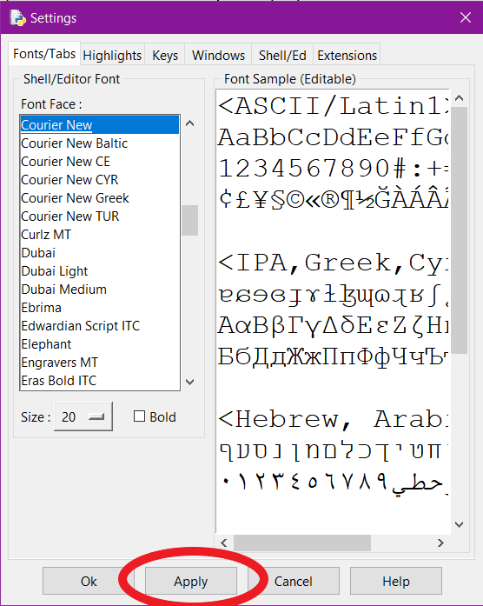

Slide 6
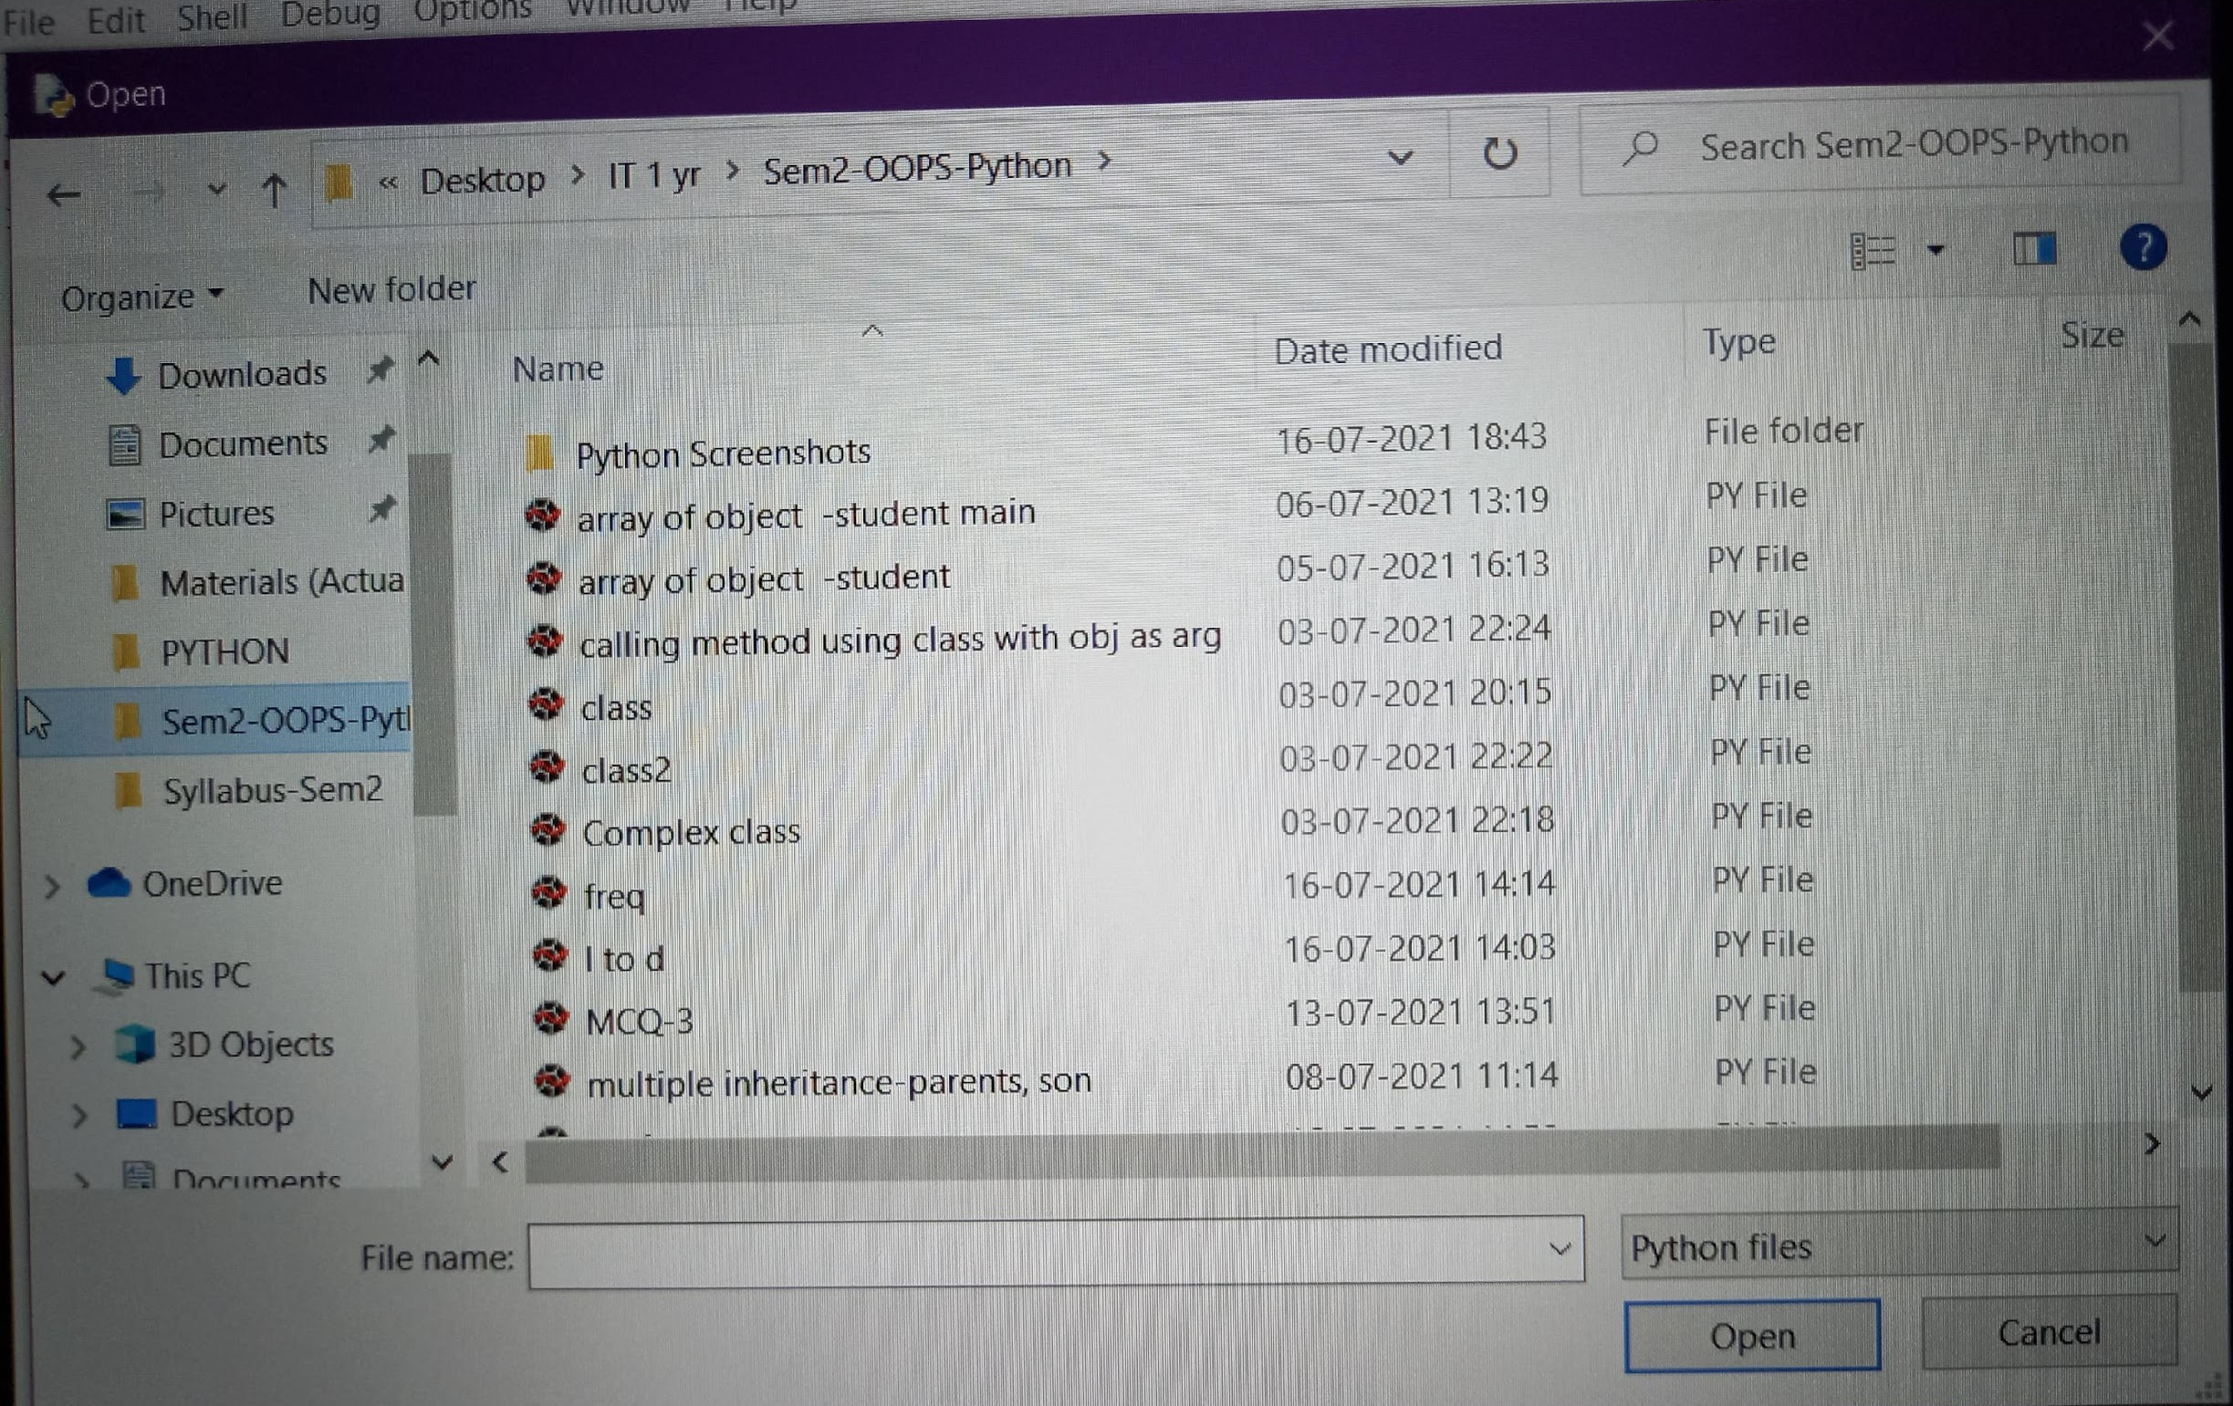
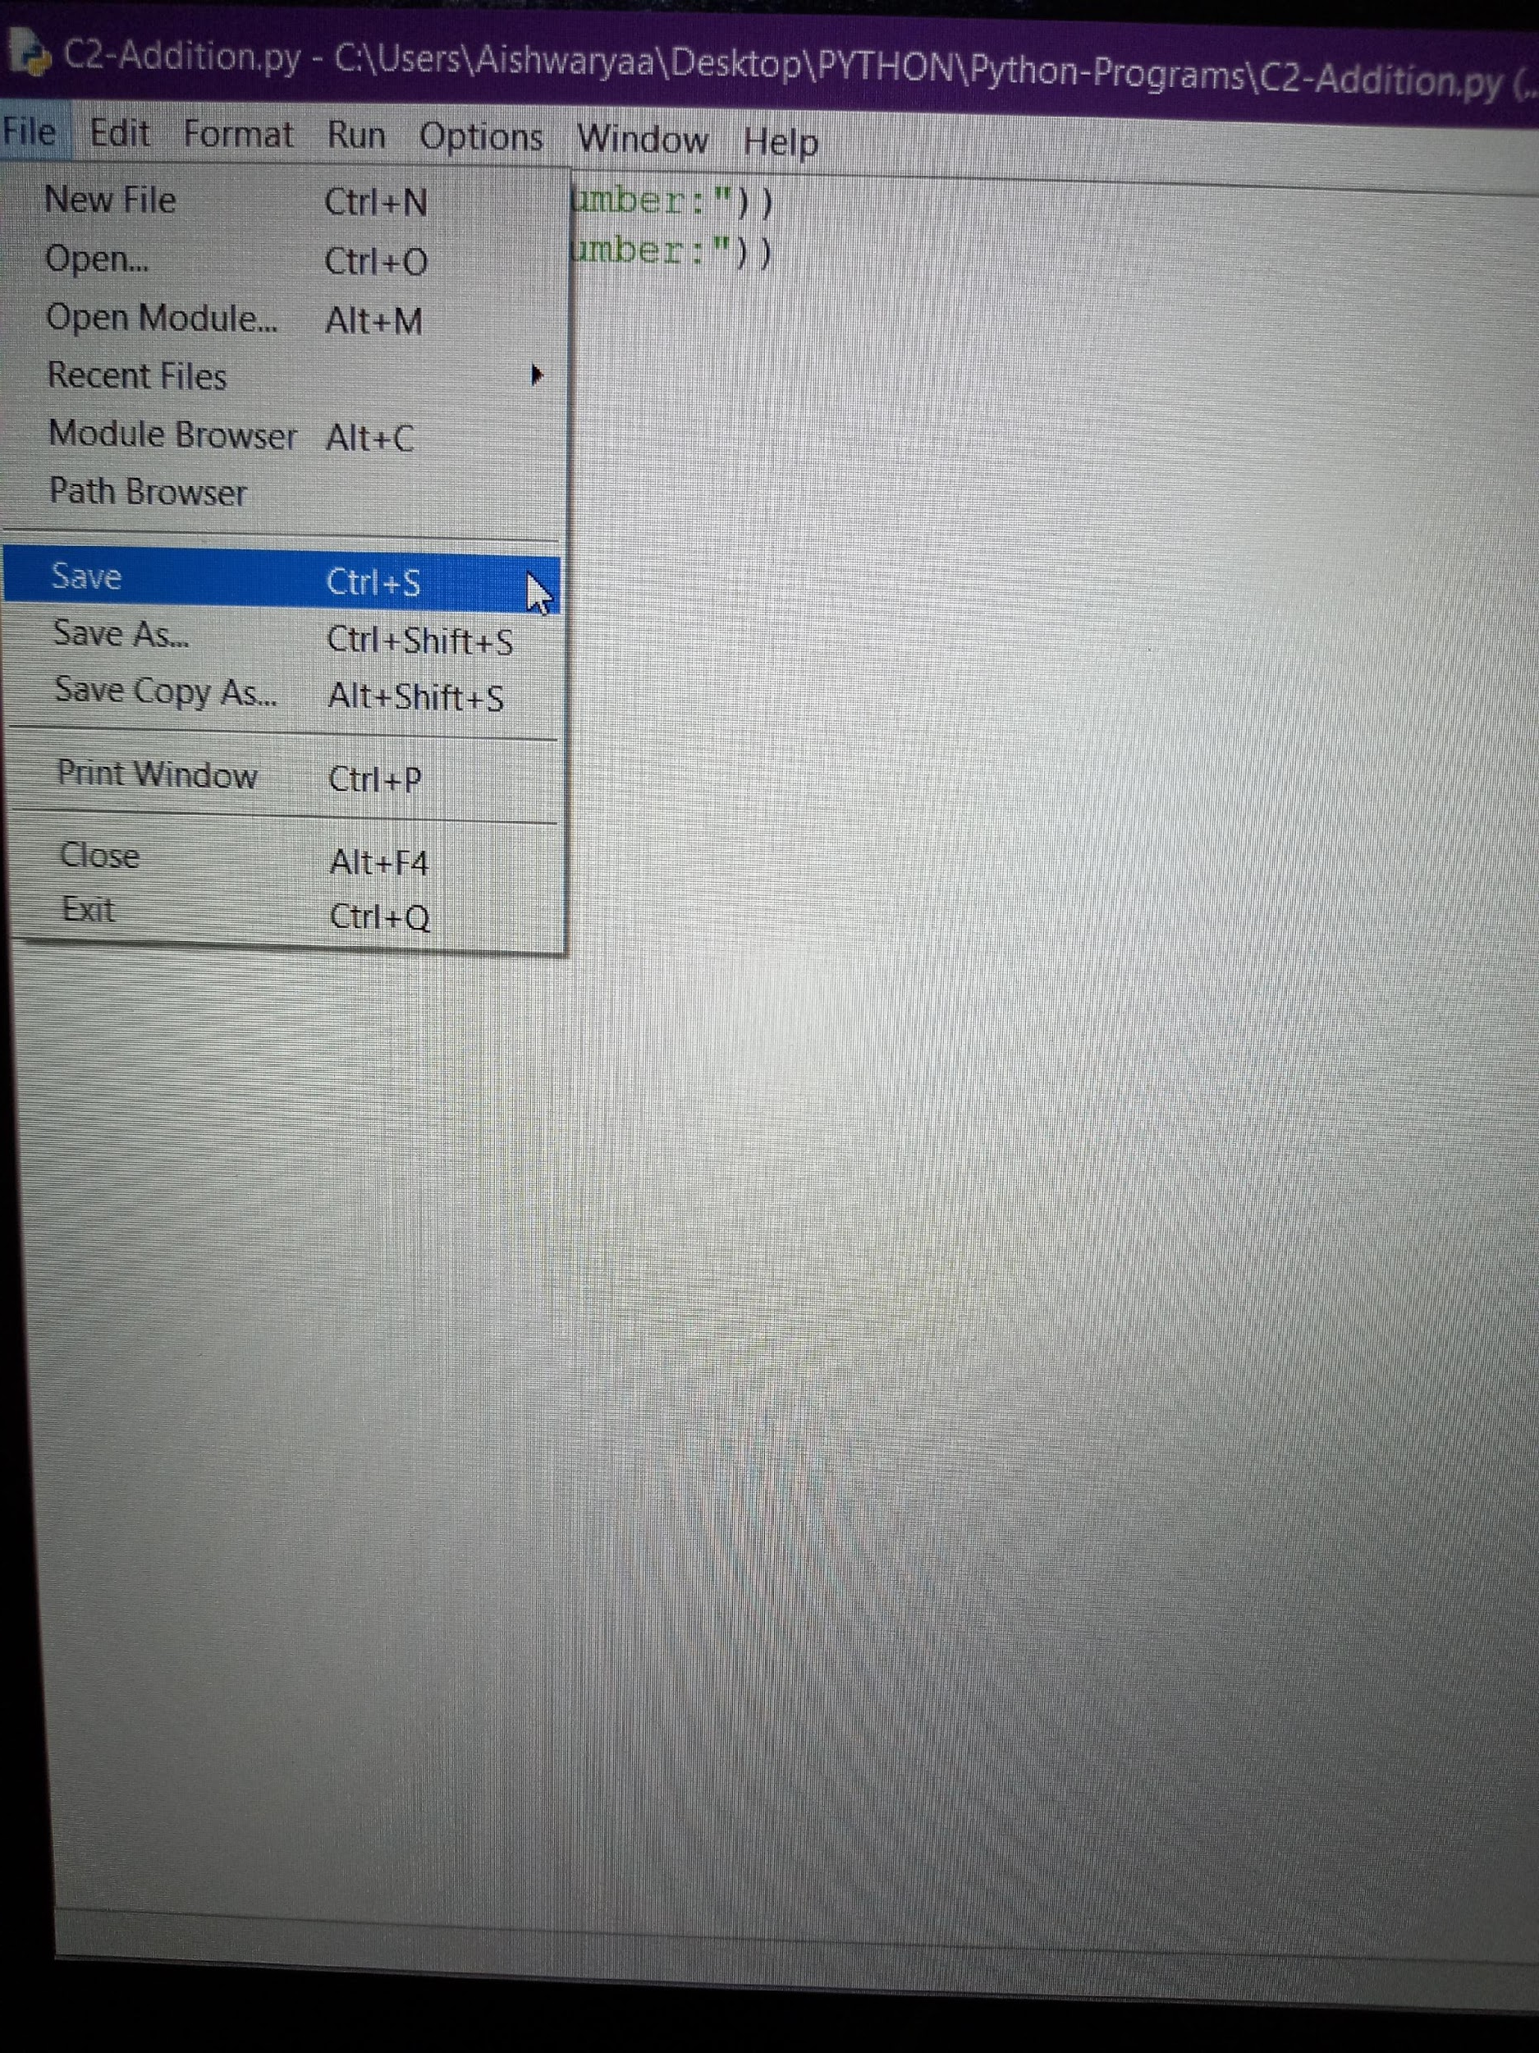
SAVE YOUR CODE
To save your code, click on File and then Save. If you are saving the code for the first time, click on Save As.
Provide a relevant name to your program for future reference.

Slide 7
SAVE YOUR CODE (Contd.)
It is mandatory to save your code before running it.
Every time you make changes, you need to save your code.
It is recommended to provide a relevant name to your program for future reference.

Slide 8

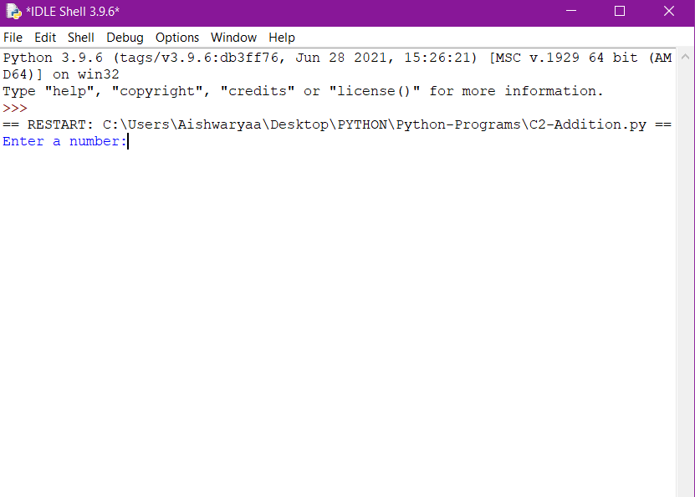
RUN YOUR CODE
To run/execute your code, click on Run and then Run Module.
The code will be run in the IDLE Console.

Slide 9
Happy Learning!

